Slide 1
Development of an AI-System for Classification of Error Causes in Large Log Files within a CI Environment
Entwicklung eines KI-Systems zur Klassifizierung von Fehleruhrsachen in Massiven Log Files einer CI-Umgebung
PE-303S / JC-31

Slide 2
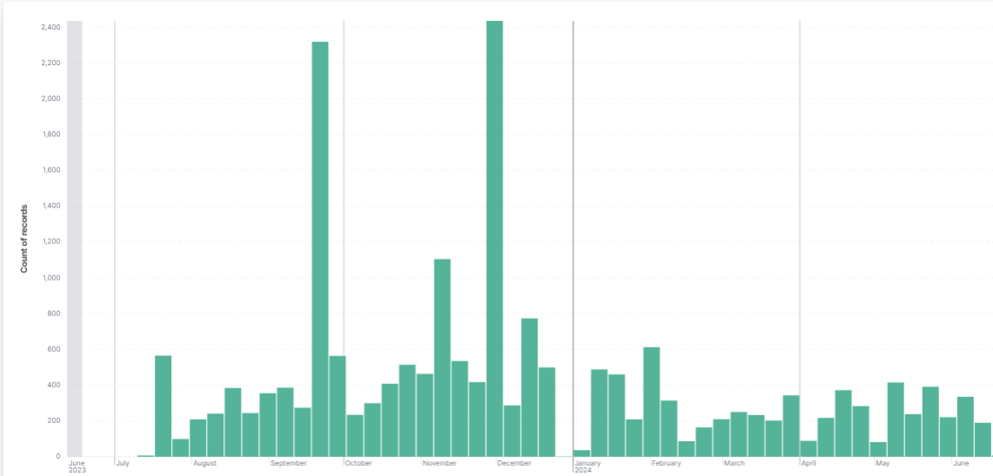
THE PROBLEM
Up to 2400 failed build per week
- Manual search for reason = Highly inefficient

Slide 3



DDAD CI GrowTH
2019
2023
20k builds per day
80k builds per day
2.8k vCPUs peak usage
37k vCPUs peak usage
1 ECU
9 ECUs + 1 SW Platform
Due to the growth we need to find measures to keep feedback fast and costs down

Slide 4
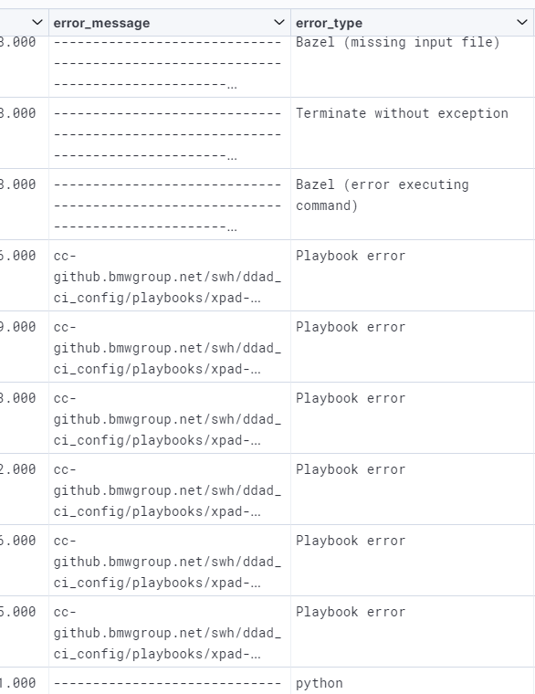
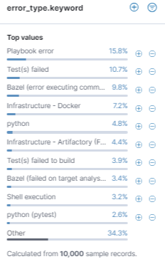
THE PROBLEM
Known error_types are defined using a RegEx Filter checking the log-file
RegEx new types are manually added to RegEx
Currently: 80 known error types
Undefined errors = “Playbook Errors”
Manually search reason
Adjust RegEx accordingly
2023: 15% ‘Unknown Errors‘ out of 20.000 failed builds

Slide 5
The Solution
=> Automate error type classification

Slide 6
The Approach
1. Create Training Data
Make logs easily accessible
Crop logs to relevant information
Label known errors (using RegEx)
Figure out way to label Playbook errors (Uncategorized)
2. Model
Choose architecture (Unet? YOLO? AlexNET? ResNet? …?)
Modeling Approach (Stemming, Bag of words vs. Sequential, Tokenization, …?)
Implement
Train, validate, improve
(Enable continual Learning?) Probably to complex, maybe for ‘Outlook’ section
3. Documentation
Aka "the actual writing"

Slide 7
Current Status
1. Create Training Data
Make logs easily accessible
Crop logs to relevant information
Label known errors (using RegEx)
Figure out way to label Playbook errors (Uncategorized)
2. Model
Choose architecture (Unet? YOLO? AlexNET? ResNet? …?)
Modeling Approach (Stemming, Bag of words vs. Sequential, Tokenization, …?)
Implement
Train, validate, improve
(Enable continual Learning?) Probably to complex, maybe for ‘Outlook’ section
3. Documentation
Aka "the actual writing"

Slide 8
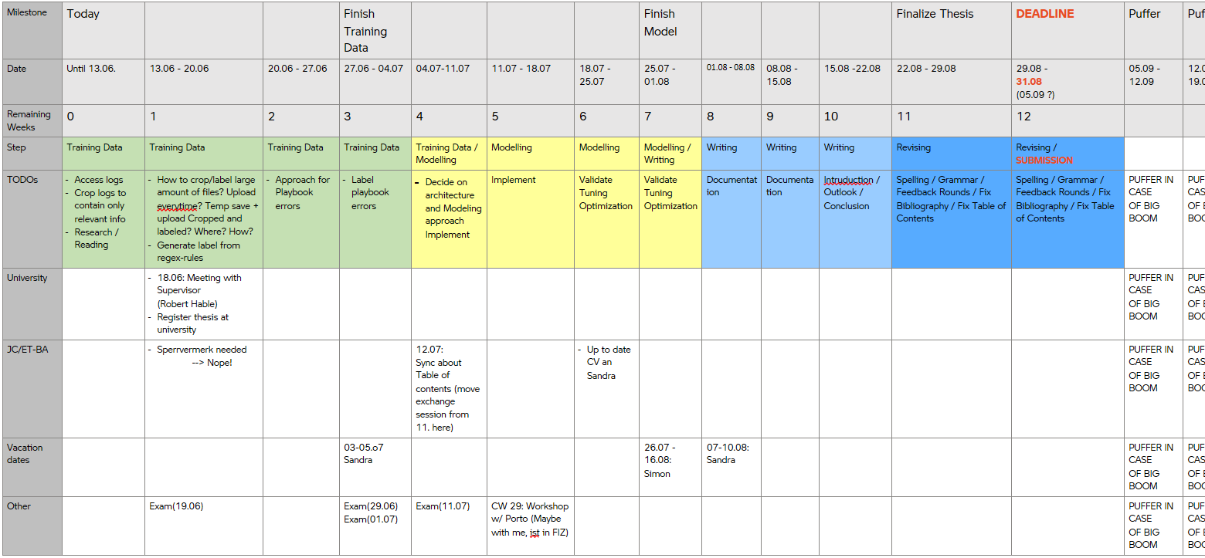
Tentative Schedule

Slide 9
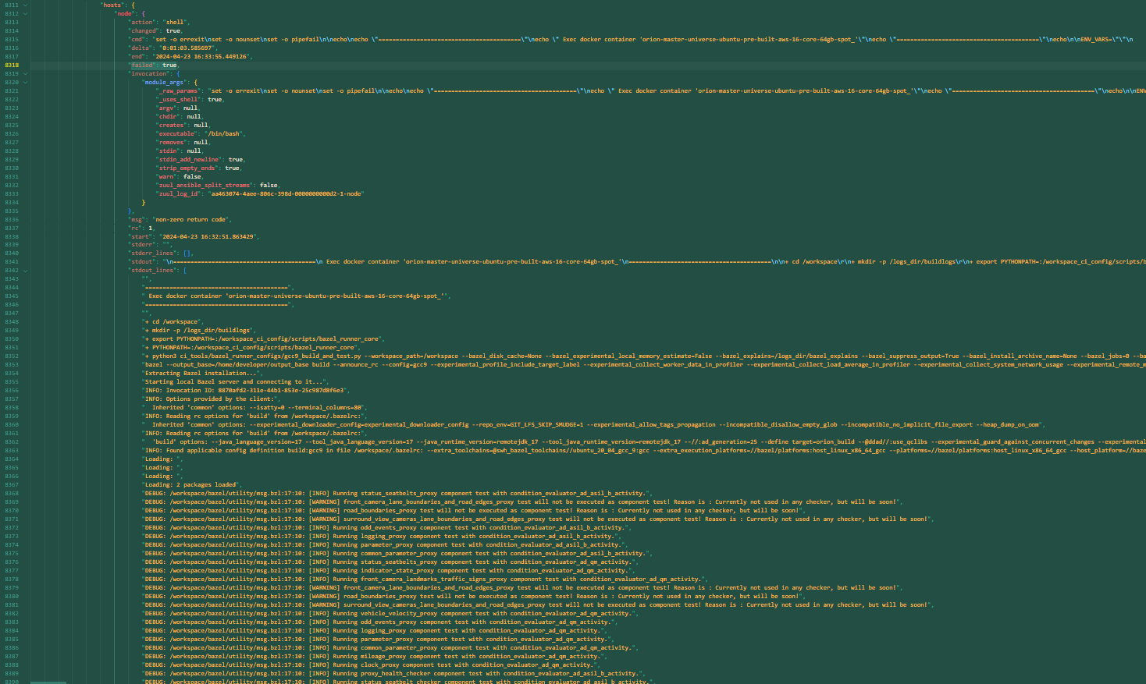
Example log

Slide 10
MISC
No „Sperrvermerk“ needed
Main thesis language: English
End of Contract with BMW: 31.08.2024

